Slide 1
Reversible Logic Gates and Circuits
Seminar Presentation
A.Kamaraj
1414489180,
Part-time Ph.D. Scholar
Department of ECE,
Mepco Schlenk Engineering College, Sivakasi
Supervisor
Dr.P.Marichamy,
Department of ECE,
P.S.R. Engineering College, Sivakasi

Slide 2
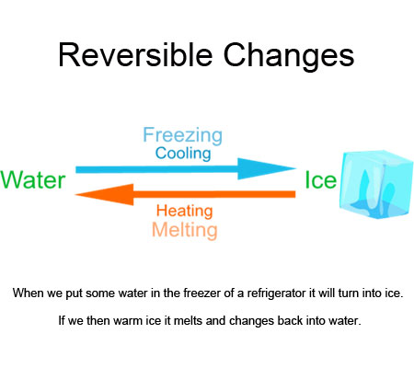
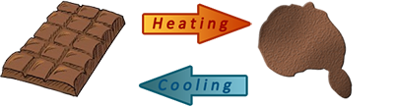

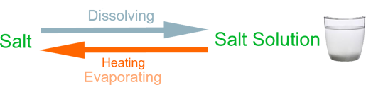
Reversibility in Real Life

Slide 3
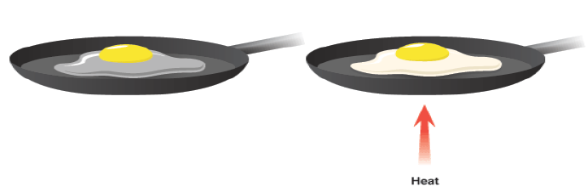
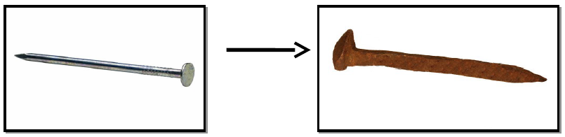
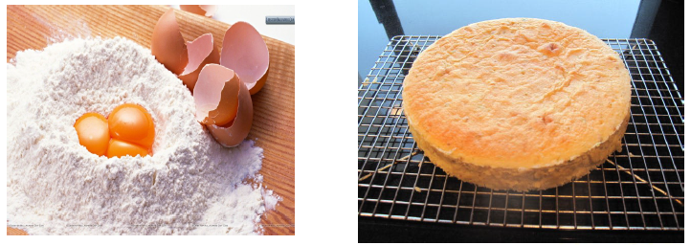

Irreversibility

Slide 4
What is reversible logic?
A gate or a circuit is reversible if the mapping from the inputs to the outputs is bijective.
Number of inputs is equal to number of outputs; have one-to-one mapping.
Minimum number of garbage outputs.
i
O
1
1
i
O
2
2
i
O
3
Reversible
Gate
3
i
O
K-1
K-1
i
O
K
K

Slide 5
Why Reversible Logic?
It has been proved ( by Bennett and Landauer) that ,
“losing information in a circuit causes losing power. Information lost when the input vector cannot be uniquely recovered from the output vector of a combinational circuit”.
The gate/ circuit does not loose information is called reversible.
kT * log 2 Joules of heat energy for every bit of information that is lost.

Slide 6
Difference Between Reversible Gate and Irreversible Gate
Conventional gate dissipates energy because it discards information.
Reversible gates does not dissipate energy because there is no information erasure.
A
A
A
A
B
B
B
B
0
A&B
0
A&B

Slide 7
Reversibility
For any deterministic device to be reversible is that its input and output be uniquely retrievable from each other - then it is called logically reversible.

Slide 8
ResearchWorks Done So far…
Combinational logic circuits:
Full Adder/Subtractor,
Encoder and Decoder,
Comparator
Sequential circuits:
Latch (D-latch, JK latch, T-latch)
Flip-flops (D-flipflop, JK flipflop, T-flipflop, SR)
Barrel shifter
Shift registers (SIPO, SISO, PISO, PIPO)

Slide 9
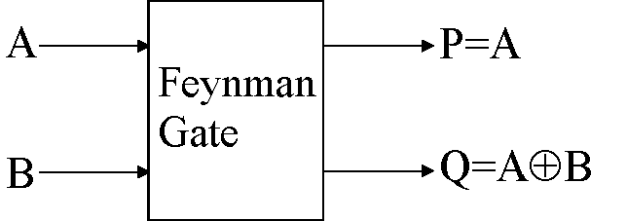
Feynman Gate
The input vector is I (A, B) and the output vector is O (P, Q).
The outputs are defined by P=A, Q=A B.
Quantum cost of a Feynman gate is 1.
A | B | P | Q
0 | 0 | 0 | 0
0 | 1 | 0 | 1
1 | 0 | 1 | 1
1 | 1 | 1 | 0

Slide 10
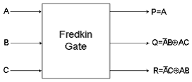
Fredkin Gate
The Fredkin gate swaps the last two bits, if the first bit is set.
Quantum cost of a Fredkin gate is 5.
A | B | C | P | Q | R
0 | 0 | 0 | 0 | 0 | 0
0 | 0 | 1 | 0 | 0 | 1
0 | 1 | 0 | 0 | 1 | 0
0 | 1 | 1 | 0 | 1 | 1
1 | 0 | 0 | 1 | 0 | 0
1 | 0 | 1 | 1 | 1 | 0
1 | 1 | 0 | 1 | 0 | 1
1 | 1 | 1 | 1 | 1 | 1

Slide 11
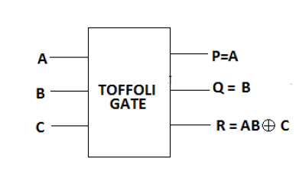
Toffoli Gate
If we want to compute an arbitrary function using reversible gates, we need another gate. One possibility is the Toffoli gate.
INPUT |  |  | OUTPUT
0 | 0 | 0 | 0 | 0 | 0
0 | 0 | 1 | 0 | 0 | 1
0 | 1 | 0 | 0 | 1 | 0
0 | 1 | 1 | 0 | 1 | 1
1 | 0 | 0 | 1 | 0 | 0
1 | 0 | 1 | 1 | 0 | 1
1 | 1 | 0 | 1 | 1 | 1
1 | 1 | 1 | 1 | 1 | 0

Slide 12
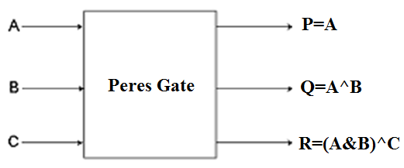
Peres Gate
Used as a half-adder, when third input is 0.
A | B | C | P | Q | R
0 | 0 | 0 | 0 | 0 | 0
0 | 0 | 1 | 0 | 0 | 1
0 | 1 | 0 | 0 | 1 | 0
0 | 1 | 1 | 0 | 1 | 1
1 | 0 | 0 | 1 | 1 | 0
1 | 0 | 1 | 1 | 1 | 1
1 | 1 | 0 | 1 | 0 | 1
1 | 1 | 1 | 1 | 0 | 0

Slide 13
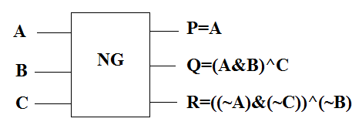
New Gate
HNG Gate
HNG
P=A
A
B
Q=B
HNG
C
R=A^B^C
D
S=((A^B)&C)^(A&B)^D

Slide 14
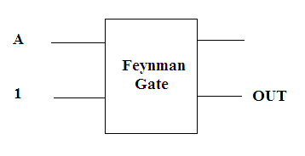
Reversible Logic Gates
Reversible NOT gate

Slide 15
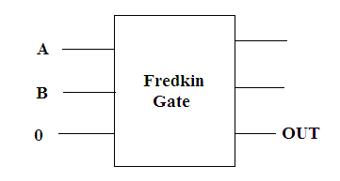
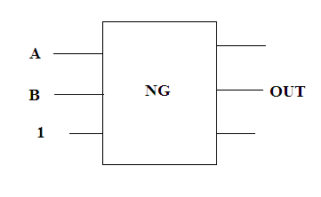
Reversible Logic Gates
Reversible AND gate
Reversible NAND gate

Slide 16
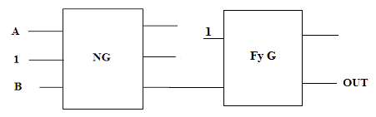
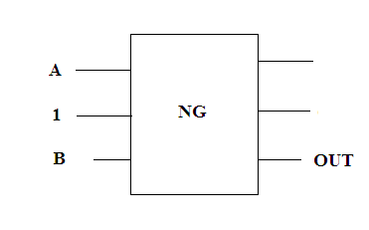
Reversible Logic Gates
Reversible OR gate
Reversible NOR gate

Slide 17
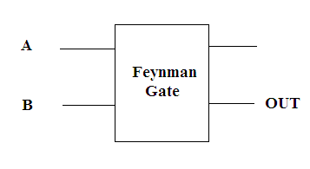
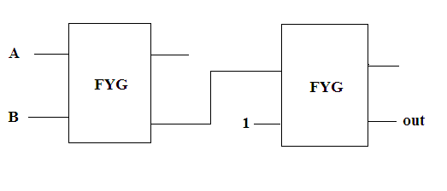
Reversible Logic Gates
Reversible XOR gate
Reversible XNOR gate

Slide 18
Universality
Universality of the Fredkin gate is verified by construction to demonstrate how the gate can be used to realize the AND / NAND, OR / NOR, and NOT operations.

Slide 19
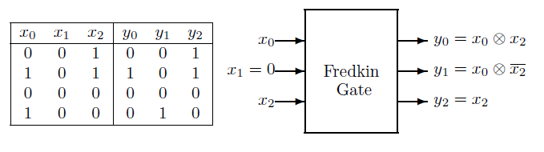
AND operation
x₁ input to 0, y₀ = x₀ ⊗x₂

Slide 20
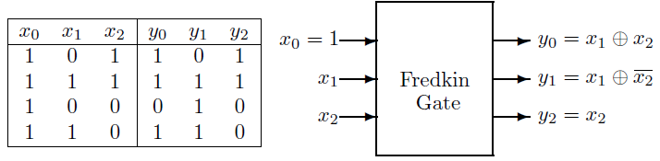
OR Operation
x₀ input to 1, y₀ = x₁ ⊕x₂

Slide 21
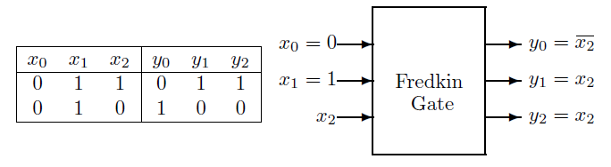
NOT operation
x₀ input to 0 and the
x₁ input to 1, and using x₂ as the input bit

Slide 22
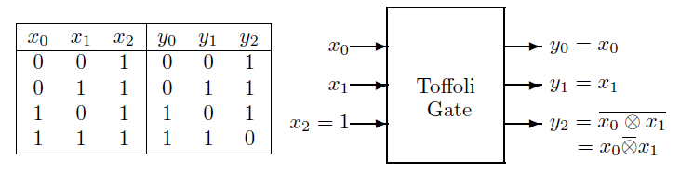
Toffoli - Universality
2-bit NAND gate
fixing x₂ at 1, the output bit y₂ gives NAND on inputs x₀ and x_{1.}

Slide 23
Fault Tolerant
A gate is parity preserving.

Slide 24
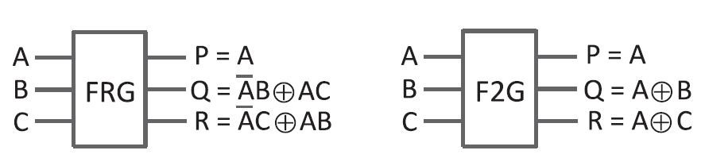
FT Gates
A | B | C | P | Q | R | FT
0 | 0 | 0 | 0 | 0 | 0 | 0
0 | 0 | 1 | 0 | 0 | 1 | 1
0 | 1 | 0 | 0 | 1 | 0 | 1
0 | 1 | 1 | 0 | 1 | 1 | 0
1 | 0 | 0 | 1 | 0 | 0 | 1
1 | 0 | 1 | 1 | 1 | 0 | 0
1 | 1 | 0 | 1 | 0 | 1 | 0
1 | 1 | 1 | 1 | 1 | 1 | 1
A | B | C | P | Q | R | FT
0 | 0 | 0 | 0 | 0 | 0 | 0
0 | 0 | 1 | 0 | 0 | 1 | 1
0 | 1 | 0 | 0 | 1 | 0 | 1
0 | 1 | 1 | 0 | 1 | 1 | 0
1 | 0 | 0 | 1 | 1 | 1 | 1
1 | 0 | 1 | 1 | 1 | 0 | 0
1 | 1 | 0 | 1 | 0 | 1 | 0
1 | 1 | 1 | 1 | 0 | 0 | 1

Slide 25
Reversible Full Adder/Subtractor

Slide 26
8-bit reversible Adder/Subtractor

Slide 27
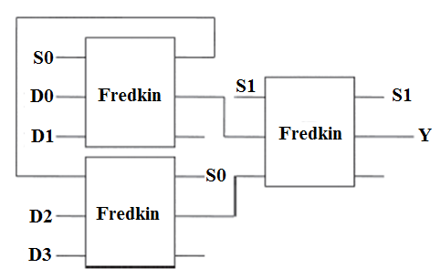
4 to 1 Reversible Multiplexer

Slide 28
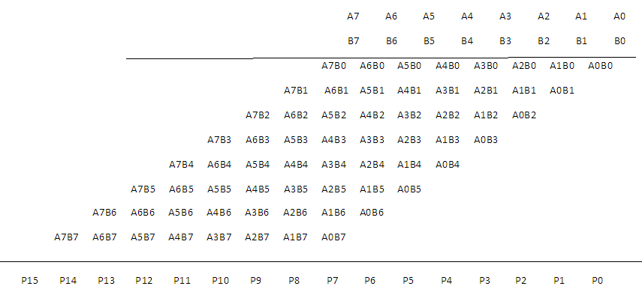
8 x 8 multiplier using partial product
Realized using 48 HNG gates and 8 Peres gates
No. of garbage outputs in the design= 103

Slide 29
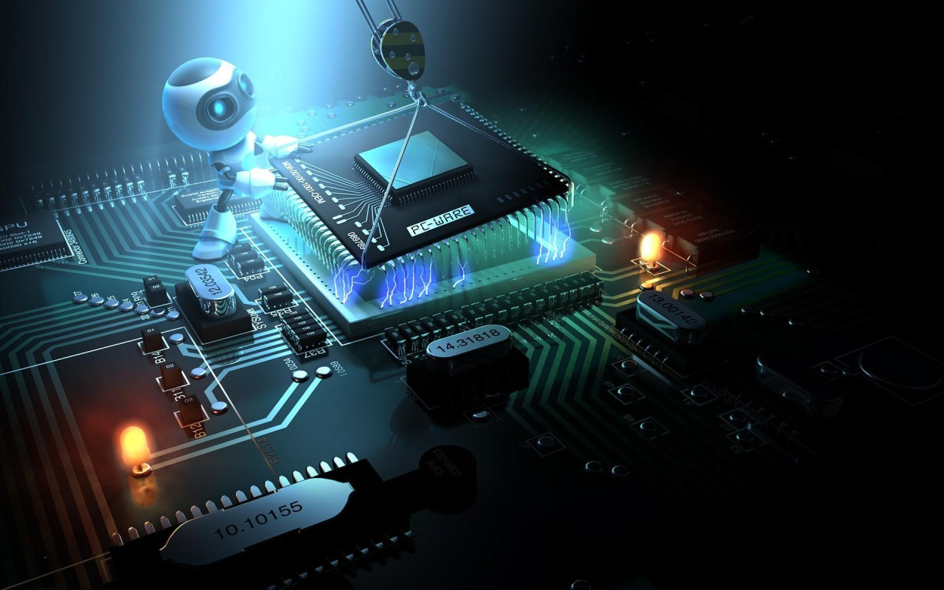

Slide 30
Quantum Cellular Automata (QCA):
A QCA cell is a coupled dot system in which four dots are at the vertices of a square. The cell has two extra electrons that occupy the diagonals within the cell due to electrostatic repulsion.
The cell polarization P measures the charge distribution along diagonal axes and is given by equation 1 (here Pi denotes the electronic charge at dot i).

Slide 31
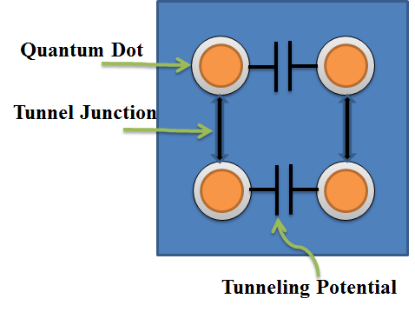
Quantum Cellular Automata (QCA)

Slide 32
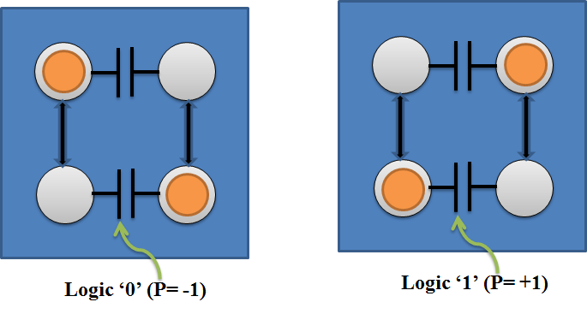
Logical Value of Quantum Dot

Slide 33
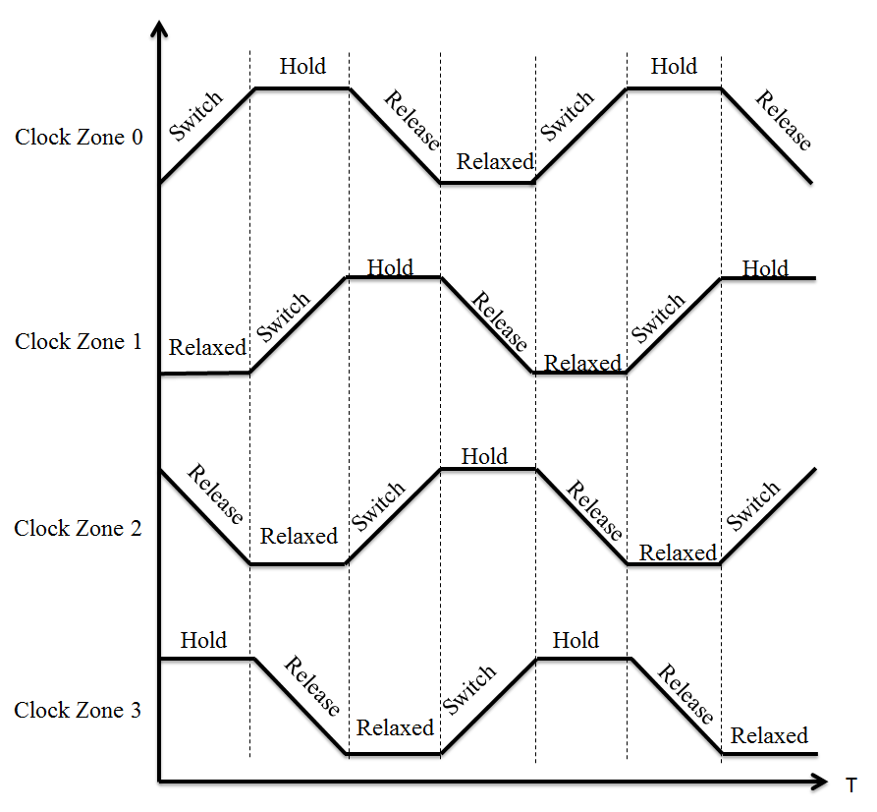
QCA Clocking

Slide 34
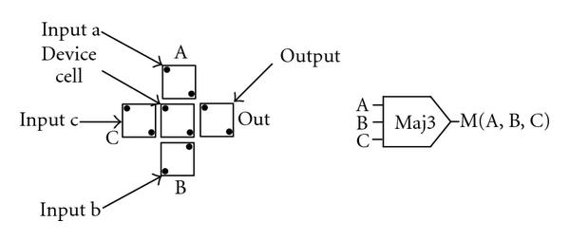
Majority voter gate

Slide 35
Types of wires in QCA
a) Binary Wire
b)Inverter Chain

Slide 36
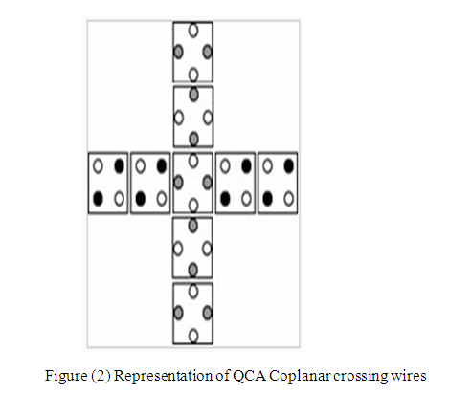
Coplanar Wire Crossing
Junction
Wire 1
Wire 2
Figure (1) Two Coplanar Crossing Wires

Slide 37
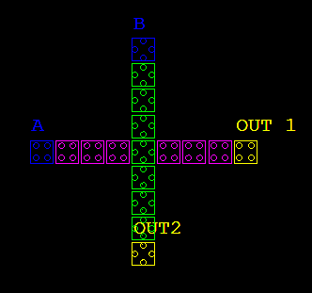
Coplanar Crossing

Slide 38
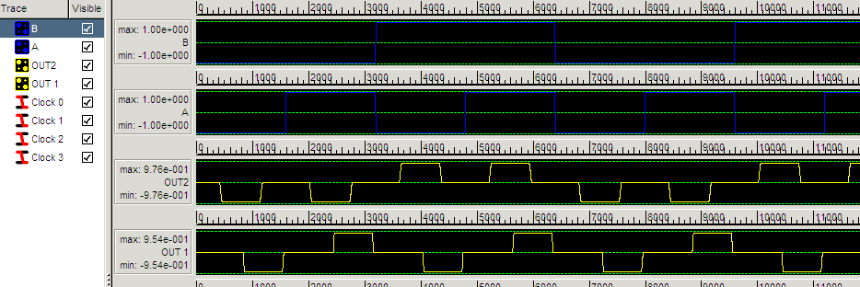
Coplanar Wire Crossing - Simulation

Slide 39
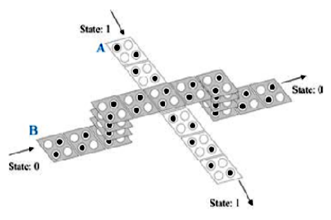
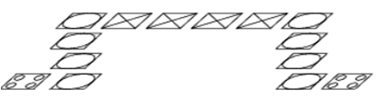


Multilayer crossing
Normal Cell
Via
Crossover

Slide 40
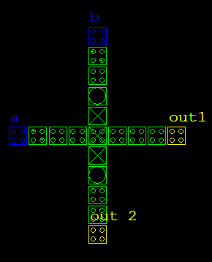
Multilayer crossing

Slide 41
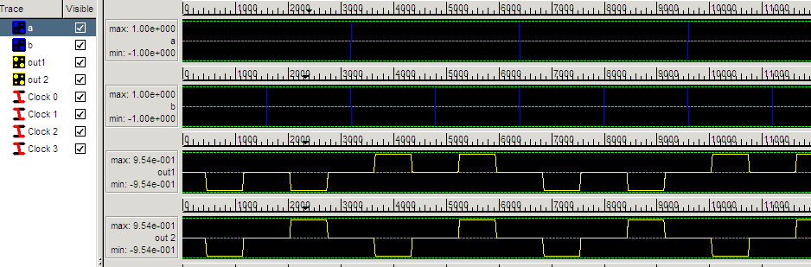
Multilayer crossing -Simulation

Slide 42

Inverter

Slide 43
COPLANAR CROSSINGS

Slide 44
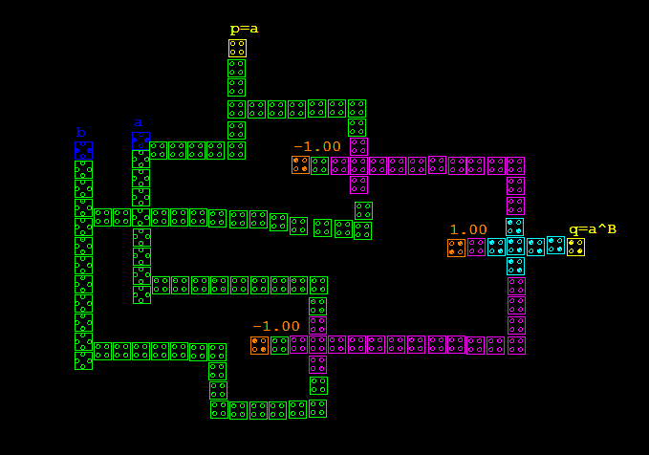
FEYNMAN GATE

Slide 45
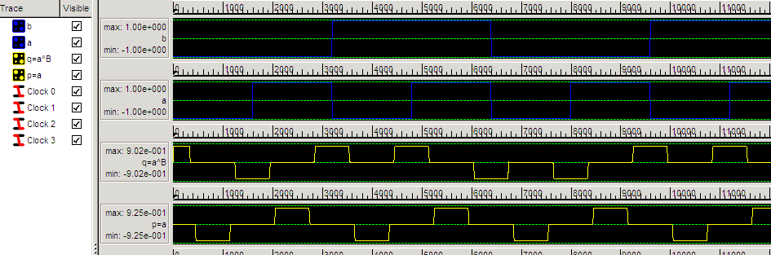
FEYNMAN GATE - Simulation

Slide 46
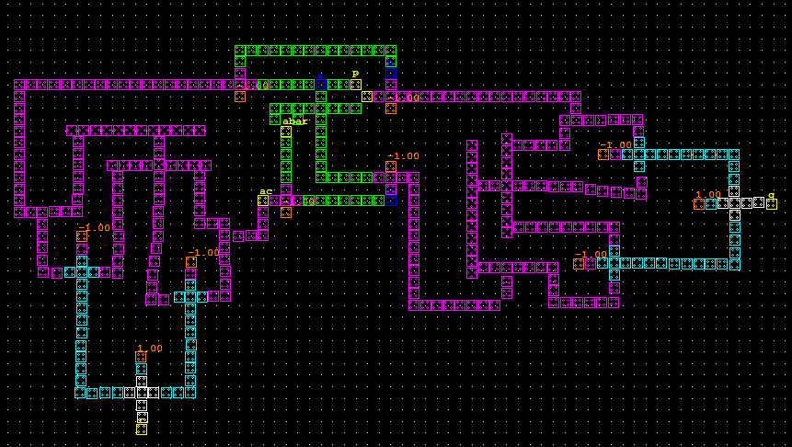
FREDKIN GATE

Slide 47
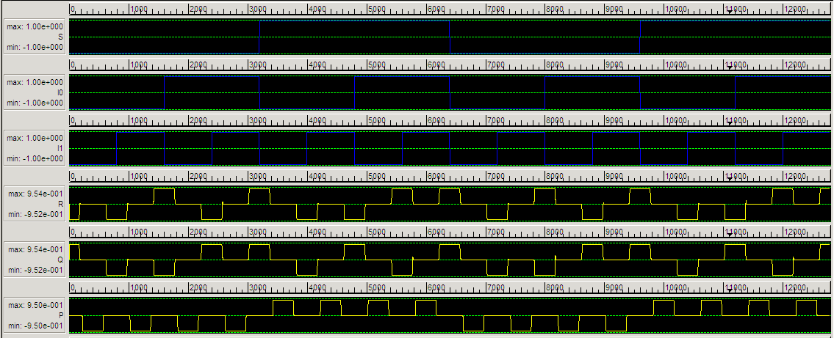
FREDKIN GATE - Simulation

Slide 48
MULTILATER CROSSING

Slide 49
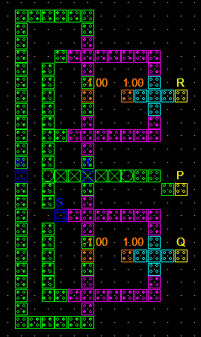
FREDKIN GATE

Slide 50
FREDKIN GATE - Simulation

Slide 51
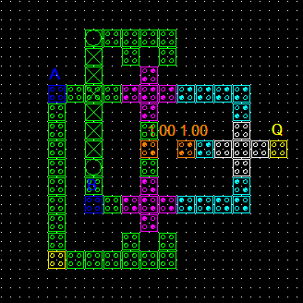
FEYNMAN GATE

Slide 52
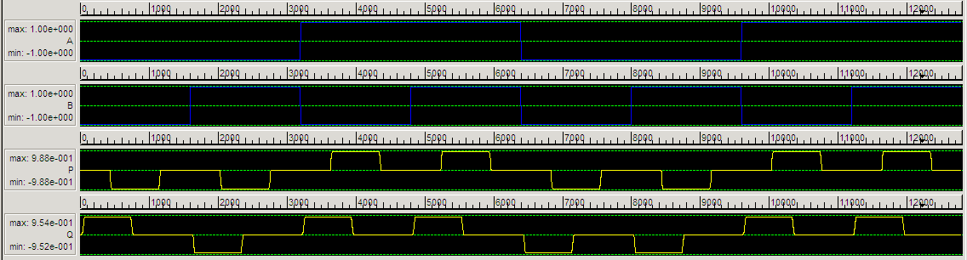
FEYNMAN GATE - Simulation

Slide 53
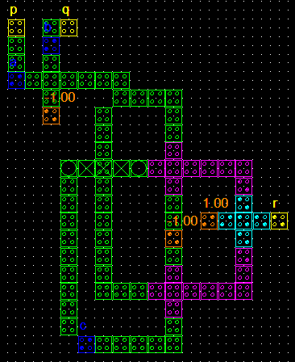
TOFFOLI GATE

Slide 54
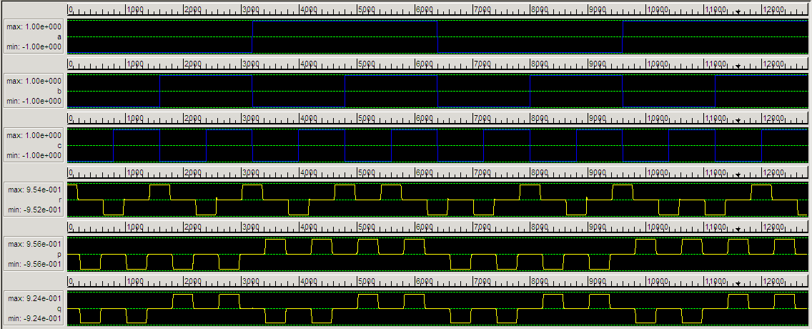
TOFFOLI GATE - Simulation

Slide 55
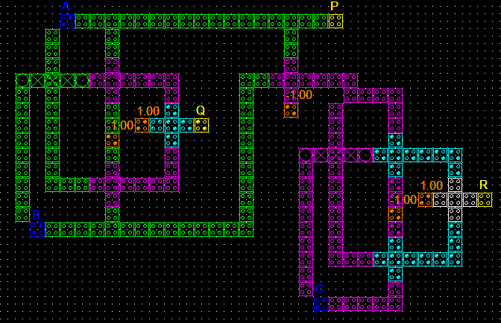
PERES GATE

Slide 56
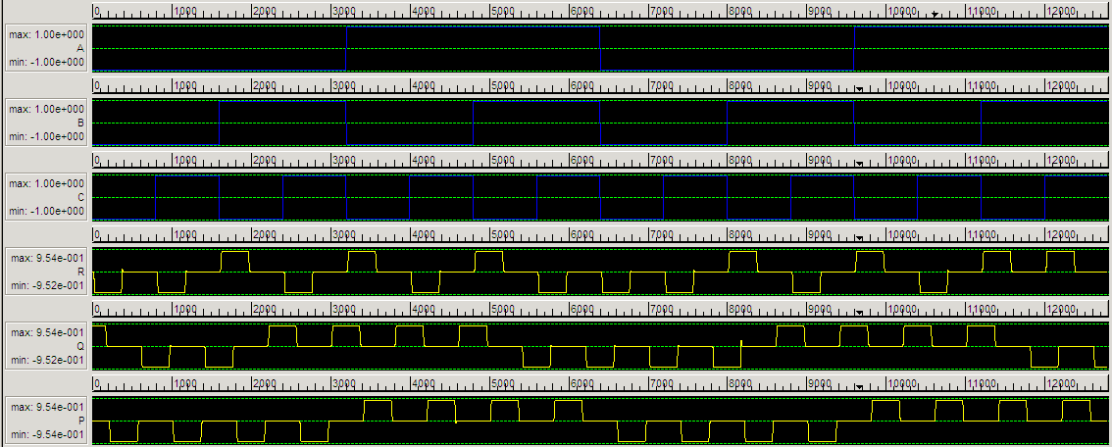
PERES GATE - Simulation

Slide 57
COPLANAR Vs MULTILAYER
 | Feynman gate |  | Fredkin gate |  | Toffoli gate |  | Peres gate
Parameters | Coplanar crossing | Multilayer crossing | Coplanar crossing | Multilayer crossing | Coplanar crossing | Multilayer crossing | Coplanar crossing | Multilayer crossing
No. of cells | 122 | 77 | 392 | 133 | 131 | 90 | 310 | 194
Area-nm² | 39528 | 24948 | 127008 | 43092 | 42444 | 29160 | 100440 | 62856
Simulation time | 34s | 27s | 96s | 45s | 45s | 35s | 87s | 65s

Slide 58
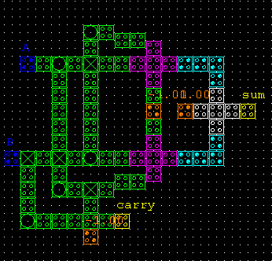
Half Adder
A
M
0
0
1
SUM
M
M
B
M
CARRY
0

Slide 59
Full Adder
A
M
Sum
M
0
M
0
1
1
M
0
M
M
B
M
Cout
0
M
M
Cin
0
0

Slide 60
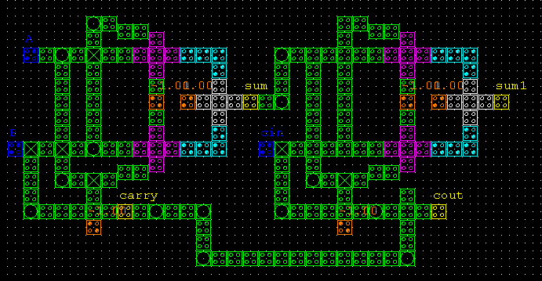
Full Adder

Slide 61

Memory Cell
Memory Cell
AND
R/W
2 X1
MUX
INPUT
ROW SELECT
LOGIC 0

Slide 62

Memory Cell – Simulation Output
ROW SELECT
1
1
READ
1
1
1
1
1
1
INPUT
0
0
0
0
0
0
0
0
1
1
1

Slide 63

Memory Array
DECODER
2:4
INPUT
MEMORY CELL
READ LINE
MUTI LAYER

Slide 64
Conclusion
Reversible Computing is an attractive research area.
Try to solve reversible problems

Slide 65


